Slide 1



Hands-on: Logistic Regression
Notes:
So now we have gathered an idea of what Data Visualization and Matplotlib is. Let us go ahead and see how to work with Matplotlib.

Slide 2
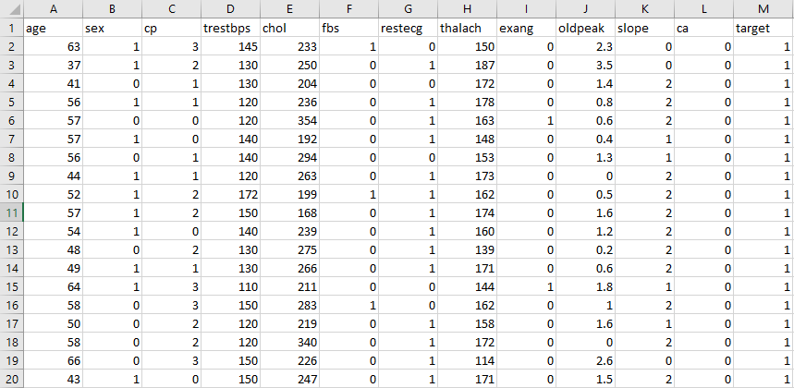
We will be using the Heart Disease Dataset, with 303 rows and 13 attributes with a target column.
In this example we will build a classifier to predict if a patient has heart disease of not.
Demo- Logistic Regression

Slide 3
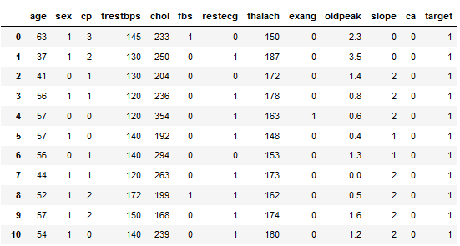

Logistic Regression
Loading the Heart dataset:
1
Having a glance at the dataset:
2
Having a look at the shape of the dataset:
3
Notes:
Let us see how the operations on Pandas work. First we will see how to perform importing of any dataset. After that we will analyze data Then we’ll manipulate data.. At last we will perform data visualization.

Slide 4

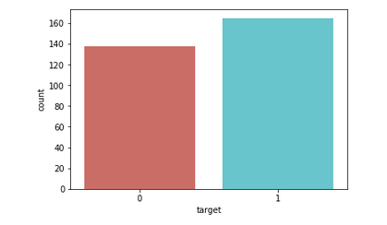

Logistic Regression
Visualizing the change in the variables
1
Visualizing the change in the variables
2
Notes:
Let us see how the operations on Pandas work. First we will see how to perform importing of any dataset. After that we will analyze data Then we’ll manipulate data.. At last we will perform data visualization.

Slide 5
Logistic Regression
Divide the data into independent and dependent variables:
1
Split the data into train and test set:
2
Notes:
Let us see how the operations on Pandas work. First we will see how to perform importing of any dataset. After that we will analyze data Then we’ll manipulate data.. At last we will perform data visualization.

Slide 6


Logistic Regression
Train the algorithm:
1
Predicting the test set results:
2
Notes:
Let us see how the operations on Pandas work. First we will see how to perform importing of any dataset. After that we will analyze data Then we’ll manipulate data.. At last we will perform data visualization.

Slide 7
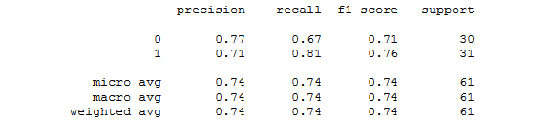
Logistic Regression
Calculating accuracy:
1
Evaluate the model using Confusion Matrix:
2
Notes:
Let us see how the operations on Pandas work. First we will see how to perform importing of any dataset. After that we will analyze data Then we’ll manipulate data.. At last we will perform data visualization.

Slide 8
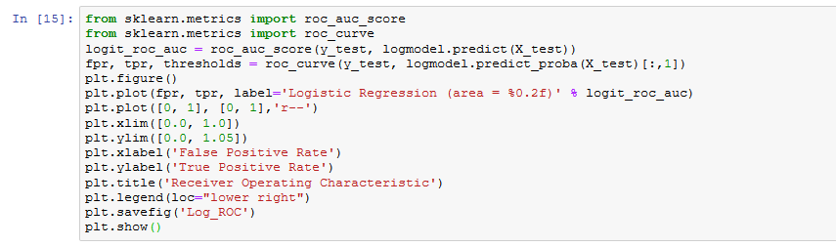
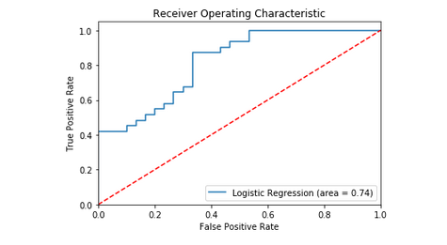
Logistic Regression
Evaluating the Algorithm with ROC curve:
Notes:
Let us see how the operations on Pandas work. First we will see how to perform importing of any dataset. After that we will analyze data Then we’ll manipulate data.. At last we will perform data visualization.

